Slide 1

Aurora Automotive
Customer Segmentation
Data Science Team:
Evgenia Iliogamvrou
Paris Krystallis
Petros Batakis

Slide 2
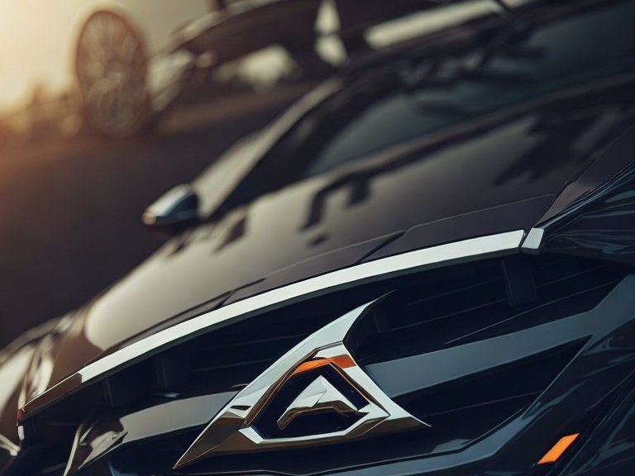
Contents
Why Segment the Customer Base?
Know your customer
Findings
Future Strategy

Slide 3
Why Segment?
Understand already established Customer base
Recognise different groups/patterns in Customer base
Reuse patterns/characteristics for marketing strategy optimization.
Expand/Test business value in new Markets

Slide 4
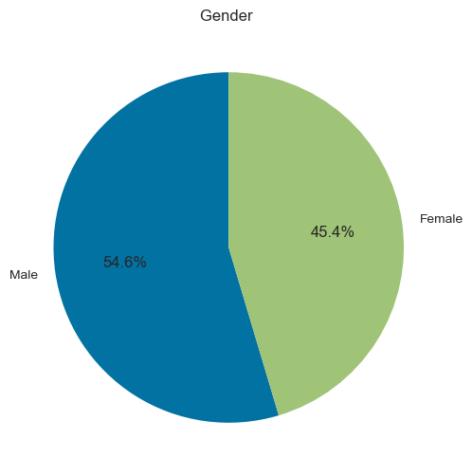
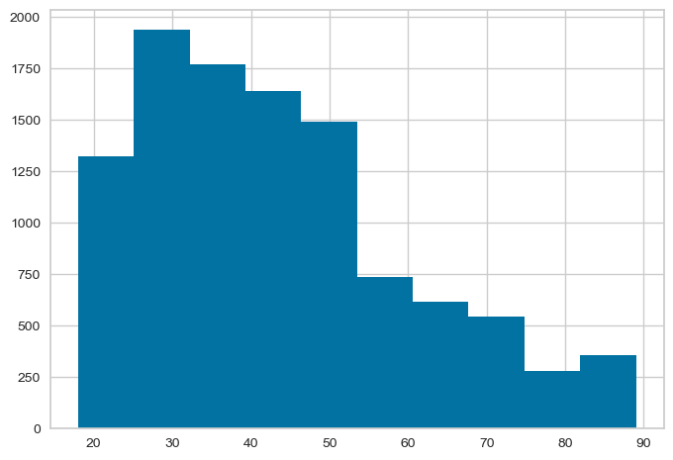
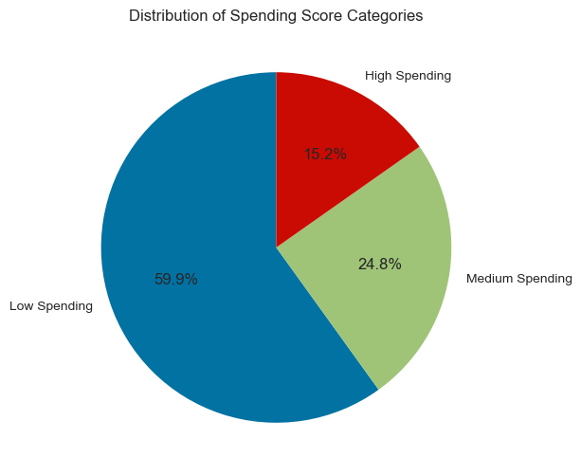
Know your customer
⚣
⚢
Who is our customer?
Age
Gender
Spending Score
Marital Status
Graduated

Slide 5
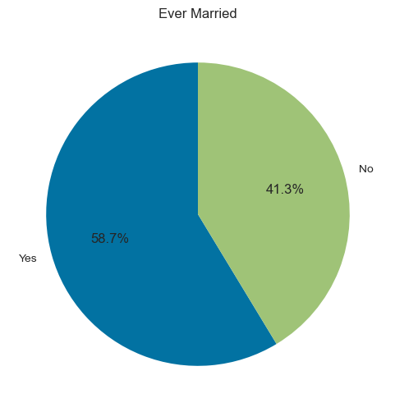
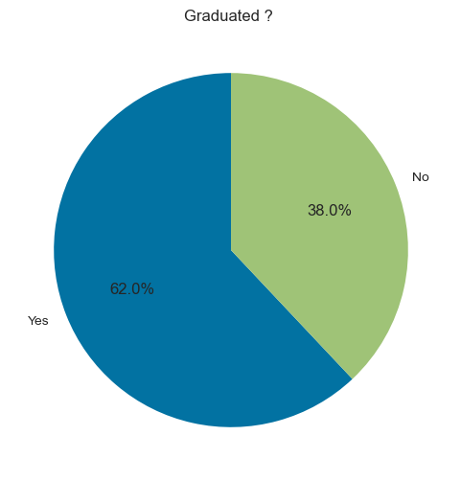
Know your customer
⚭

Slide 6
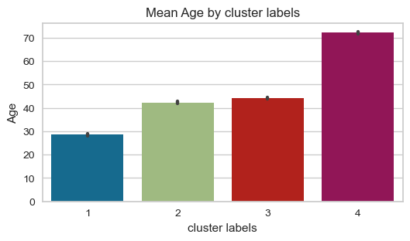
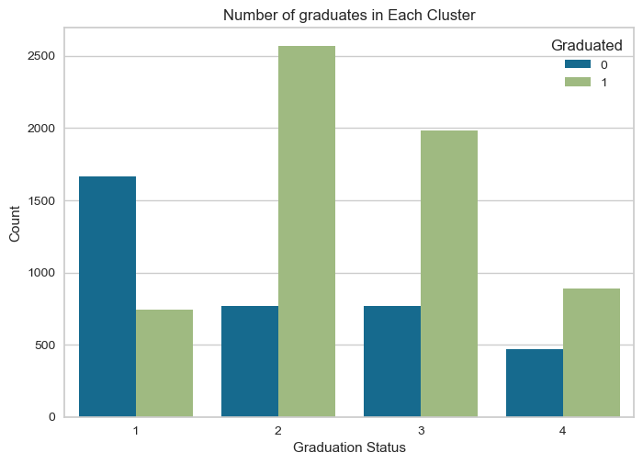
Findings
Cluster 1: Small Age, Low Graduate count → Students
Cluster 2 & 3: Middle Aged, working class
Cluster 4: Old Age
0: Not Graduated
1: Graduated

Slide 7
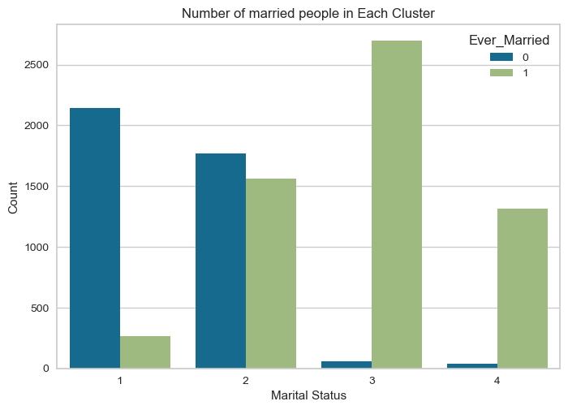
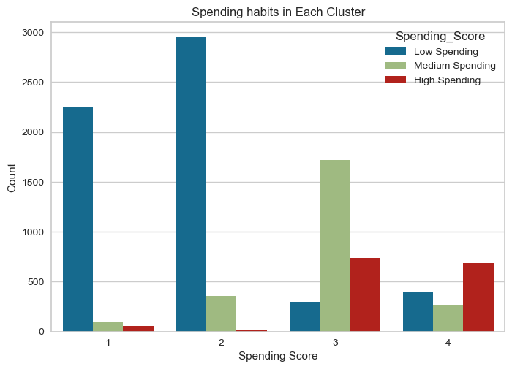
Findings
Cluster 1(Students) & 2 (Early workers, non-married) → Low Spending
Cluster 3 & 4: Middle aged, married → High Spending
0: Never Married
1: Married

Slide 8
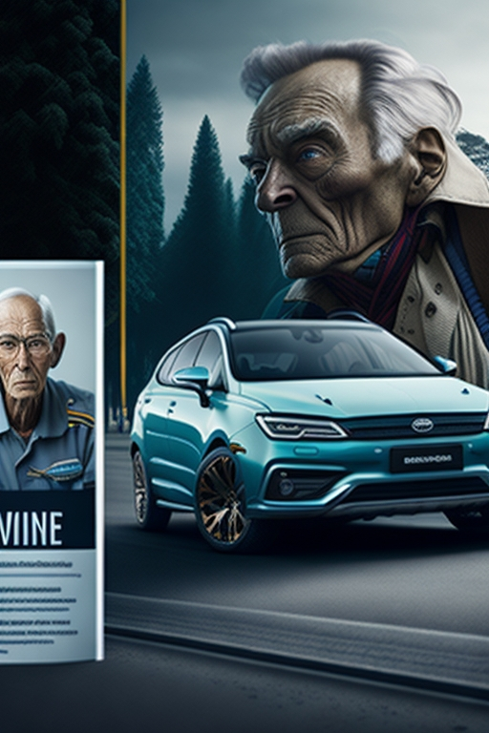
Future Strategy
Two main paths:
Focus on the main spenders
Clusters 3 and 4:
Elderly
Married
Advertising safe, ‘reasonable’
cars
Increase family car models
Offer luxury options
Tap on the lesser markets (larger pool)
Clusters 1 and 2:
Young
Single (Cluster 1) or Mix (Cluster2)
Advertising sports cars
Increase smaller, cheaper, city car
production
Offer paying by instalments

Slide 9
Thank you for your attention
Questions welcome
Aurora: Illuminating the Journey Ahead

